Slide 1
Layout
Css- Layout
- Floats (Outdated)
Modern
Flex -box
Css Grid

Slide 2
Layout
Flex-direction = row
Flex-direction = column

Slide 3
Layout-Flex-Box
Horizontal Axis
Container
.container{
display: flex

Slide 4
Layout-Flex-Box
Horizontal Axis
Container
Item2
Item3
Item1

Slide 5
Layout-Flex-Box
Horizontal Axis
Container
Item1
Item2
Item3

Slide 6
Layout

Slide 7
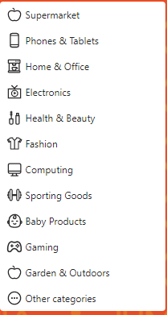
Layout

Slide 8
Logo
Home
About
Services
Logo
Login
Signup
Home
About
Services
Logo
Get Started
Home
About
Services
Logo
Home
About
Services
Get Started
Logo
Home
About
Services

